Slide 1
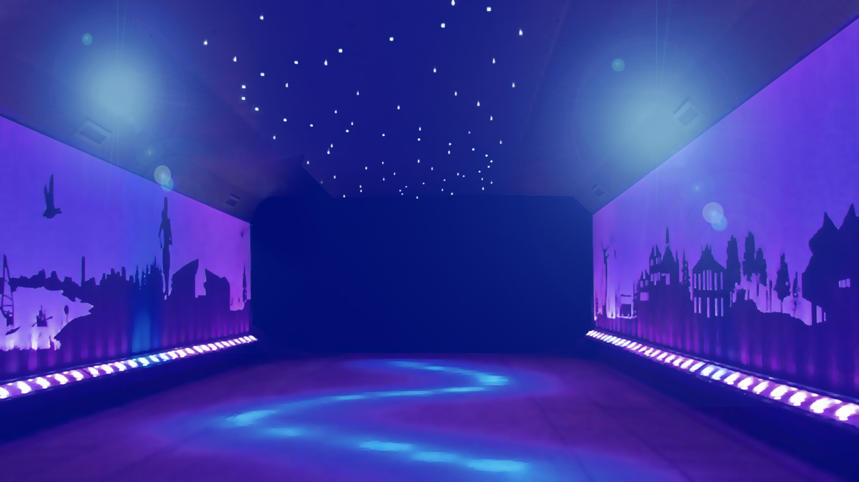

JEOPARODY JEOPARODY JEOPARODY JEOPARODY JEOPARODY JEOPARODY JEOPARODY JEOPARODY JEOPARODY JEOPARODY JEOPARODY JEOPARODY JEOPARODY JEOPARODY JEOPARODY JEOPARODY JEOPARODY JEOPARODY JEOPARODY
JEOPARODY JEOPARODY JEOPARODY JEOPARODY JEOPARODY JEOPARODY JEOPARODY JEOPARODY JEOPARODY JEOPARODY JEOPARODY JEOPARODY JEOPARODY JEOPARODY JEOPARODY JEOPARODY JEOPARODY JEOPARODY JEOPARODY

Slide 2
FAQ:
Q. Is this game officially licensed by Jeopardy!?
A. No it’s not. This game is a PARODY game.
Q. How do I reset the links on the main board back to yellow?
A. Simply close the PowerPoint file, and re-open, and the links will turn back to yellow.
Q. Why aren’t the sound effects working?
A. If the sound effects aren’t working, I would suggest upgrading your PowerPoint to something newer than 2008, and using a PC instead of a Mac if possible. Also, Google slides, Keynotes, etc. are not supported.
Q. Can I get a board with less categories? Can I add a custom logo?
A. Unfortunately these changes are a little too complex for me to explain or assist you via email, but if you’d like me to do a custom job for you for a small fee, send me an email at Reid@youthdownloads.com.

Slide 3
HERE ARE TODAY’S CATEGORIES

Slide 4

CLEANING AND DISINFECTION

Slide 5
VACCINATIONS

Slide 6
PERSONAL PROTECTIVE EQUIPMENT

Slide 7
RESPIRATORY ETIQUETTE

Slide 8
INJECTION SAFETY

Slide 9
LET’S BEGIN!

Slide 10
CLEANING AND DISINFECTION
PERSONAL PROTECTIVE EQUIPMENT
RESPIRATORY ETIQUETTE
INJECTION SAFETY
VACCINATIONS
$100
$100
$100
$100
$100
$200
$200
$200
$200
$200
$300
$300
$300
$300
$300
$400
$400
$400
$400
$400
$500
$500
$500
$500
$500
FINAL JEOPARODY

Slide 11
SURFACES IN A PATIENT ROOM THAT MAY BECOME VERY CONTAMINATED, INCLUDING BED RAILS, CALL BUTTONS, AND TRAY TABLES.

Slide 12
WHAT ARE HIGH TOUCH SURFACES?

Slide 13
THE AMOUNT OF TIME A PRODUCT MUST BE ON A SURFACE IN ORDER TO EFFECTIVELY DISINFECT IT.

Slide 14
WHAT IS CONTACT TIME?

Slide 15
A FORM OF DECONTAMINATION THAT RENDERS THE ENVIRONMENTAL SURFACE SAFE TO HANDLE BY REMOVING VISIBLE SOILS.

Slide 16
WHAT IS CLEANING?

Slide 17
THE ORGANIZATION THAT VERIFIES MANUFACTURERS’ CLAIMS TO INACTIVATE MICROORGANISMS FOR SELECTED PRODUCTS AND ORGANISMS IN THE US.

Slide 18
WHAT IS THE EPA?

Slide 19
A CLASSIFICATION SCHEME THAT CATEGORIZES ITEMS AS CRITICAL, SEMICRITICAL, AND NONCRITICAL BASED ON RISK FOR INFECTION INVOLVED IN USE OF THE ITEMS.

Slide 20
WHAT IS SPAULDING CLASSIFICATION?

Slide 21
THE VARICELLA VACCINE IS USED TO IMMUNIZE AGAINST THIS VIRUS.

Slide 22
WHAT IS CHICKEN POX?

Slide 23
PERTUSSIS IS ALSO KNOWN BY THIS NAME BECAUSE OF THE SOUND MADE FROM THOSE WHO HAVE IT.

Slide 24
WHAT IS WHOOPING COUGH?

Slide 25
VACCINES ARE GIVEN TO HELP DO THIS TO A PERSON’S SUSCEPTIBILITY TO GETTING A SPECIFIC DISEASE.

Slide 26
WHAT IS DECREASE IT?

Slide 27
MMR IS A VACCINE GIVEN TO COVER THESE HIGHLY CONTAGIOUS ILLNESSES.

Slide 28
WHAT ARE MEASLES, MUMPS, AND RUBELLA?

Slide 29
THIS IS THE RECOMMENDED AGE FOR PEOPLE TO RECEIVE THE FLU, SHINGLES, AND PNEUMONIA VACCINES.

Slide 30
WHAT IS 65?

Slide 31
A NON-STERILE FLUID- RESISTANT TYPE OF PPE WORN BY HCW TO KEEP CLOTHING FROM BECOMING CONTAMINATED WITH ORGANISMS AND POTENTIALLY INFECTED MATERIALS.

Slide 32
WHAT IS AN ISOLATION GOWN?

Slide 33
INDICATED IN SITUATIONS WHEN THERE IS POTENTIAL FOR CONTACT WITH INFECTIOUS MATERIAL.

Slide 34
WHAT ARE GLOVES?

Slide 35
THE PROCESS OF REMOVING PERSONAL PROTECTIVE EQUIPMENT AFTER USE.

Slide 36
WHAT IS DOFFING?

Slide 37
THE MINIMUM PPE THAT ARE REQUIRED FOR CONTACT PRECAUTIONS.

Slide 38
WHAT ARE A GOWN AND GLOVES?

Slide 39
A FACEPIECE RESPIRATOR THAT FILTERS AT LEAST 95% OF AIRBORNE PARTICLES THAT HAVE A DIAMETER OF 0.3 MICROMETERS OR MORE.

Slide 40
WHAT IS AN N95 RESPIRATOR?

Slide 41
YOUR NOSE AND MOUTH SHOULD BE COVERED WITH THIS COMMON ITEM WHEN COUGHING OR SNEEZING.

Slide 42
WHAT IS A TISSUE?

Slide 43
SMALL PARTICLES, USUALLY LESS THAN 5 MICROMETERS, THAT ARE RELEASED WHEN COUGHING OR SNEEZING.

Slide 44
WHAT ARE DROPLETS?
Notes:
The largest bowling alley, Inazawa Grand Bowl bowling centre (Japan), consists of 116 lanes, is 198.39 meters (650.88 ft) in length, and opened on 24 March 1972. The centre was completed on 17 March 1972; it has an area of approximately 8500 m² with a floor space of 17000 m².

Slide 45
THE USE OF RESPIRATORS OR FACEMASKS TO COVER A PERSON'S MOUTH AND NOSE TO PREVENT SPREAD OF RESPIRATORY SECRETIONS.

Slide 46
WHAT IS SOURCE CONTROL?

Slide 47
CONTROL MEASURES THAT CAN PREVENT THE SPREAD OF ALL RESPIRATORY INFECTIONS.

Slide 48
WHAT IS RESPIRATORY HYGIENE/COUGH ETIQUETTE?

Slide 49
THIS TYPE OF TRANSMISSION OCCURS WHEN VERY SMALL RESPIRATORY PARTICLES TRAVEL SIX FEET OR MORE FROM THE SOURCE.

Slide 50
WHAT IS RESPIRATORY TRANSMISSION?

Slide 51
THIS IS THE TECHNIQUE USED WHEN PREPARING INJECTIONS.

Slide 52
WHAT IS ASEPTIC?

Slide 53
THIS IS THE PROCESS THAT IS USED WHEN THE RUBBER STOPPER OF A MEDICATION VIAL IS WIPED WITH ALCOHOL ANY TIME PRIOR TO USE.

Slide 54
WHAT IS DISINFECT?

Slide 55
SAFE INJECTION PRACTICES HELP REDUCE THE RISK OF SPREADING INFECTIONS SUCH AS HIV, HEPATITIS B, AND HEPATITIS C, ALSO KNOWN AS THIS.

Slide 56
WHAT IS BLOOD BORNE PATHOGENS?

Slide 57
SAFE INJECTION PRACTICES ARE ALSO PART OF THIS TYPE OF PRECAUTION.

Slide 58
WHAT IS STANDARD?

Slide 59
PEP, ALSO KNOWN AS THIS, IS OFTEN GIVEN TO HEALTH CARE PROVIDERS FOR EXPOSURE TO BLOOD BORNE PATHOGENS.

Slide 60
WHAT IS POST EXPOSURE PROPHYLAXIS?

Slide 61


Slide 62
IN 1946, THIS OBSTETRICIAN DEMONSTRATED THE IMPROTANT OF HAND HYGIENE IN PREVENITNG INFECTION.
Start Timer
GO TO
PROMPT
(RESPONSE)

Slide 63
WHO IS IGNAZ SEMMELWEIS?

