Slide 1

INFECTION
PREVENTION
TRIVIA
Generations of Infection Prevention: Past, Present, Protected
An interactive team trivia game for IIPW
START GAME

Slide 2
FACILITATOR GUIDE
How to Play
1
Divide participants into 2–6 teams and choose a scorekeeper.
2
Teams select a category and point value. Read the prompt aloud.
3
Allow ~20–30 seconds to answer. Exact “question form” is not required.
4
Award the displayed points for a correct response. Optional: subtract points for an incorrect response.
5
Use the answer screen’s teaching note to reinforce the infection-prevention takeaway.
6
Finish with the Final Challenge. Highest score wins!
Tip: This deck is designed for Slide Show mode. Use the on-screen buttons to navigate.
OPEN GAME BOARD

Slide 3
CHOOSE YOUR CHALLENGE
BEFORE GERMS
CLEAN BREAKTHROUGHS
MEDICAL GAME CHANGERS
BUILT FOR PREVENTION
FUTURE OF IP
100
100
100
100
100
200
200
200
200
200
300
300
300
300
300
400
400
400
400
400
500
500
500
500
500
IIPW 2026 • Generations of Infection Prevention: Past, Present, Protected
BONUS
FINAL

Slide 4
BEFORE GERMS
100 POINTS
This name is commonly given to the devastating 14th-century plague pandemic in Europe.
REVEAL ANSWER
IIPW 2026 • Generations of Infection Prevention: Past, Present, Protected

Slide 5
BEFORE GERMS • 100
ANSWER
The Black Death
WHY IT MATTERS
The Black Death was caused by Yersinia pestis and became one of history’s most consequential infectious-disease events.
Source note: CDC/NIH historical references
BACK TO BOARD
IIPW 2026 • Generations of Infection Prevention: Past, Present, Protected

Slide 6
BEFORE GERMS
200 POINTS
Before germ theory, many people believed disease spread through poisonous or foul-smelling air. What was this theory called?
REVEAL ANSWER
IIPW 2026 • Generations of Infection Prevention: Past, Present, Protected

Slide 7
BEFORE GERMS • 200
ANSWER
Miasma theory
WHY IT MATTERS
Miasma theory attributed disease to “bad air.” Germ theory eventually displaced it as microorganisms were shown to cause disease.
Source note: Historical infection-control literature
BACK TO BOARD
IIPW 2026 • Generations of Infection Prevention: Past, Present, Protected

Slide 8
BEFORE GERMS
300 POINTS
These two scientists are closely associated with establishing germ theory and linking microorganisms to disease.
REVEAL ANSWER
IIPW 2026 • Generations of Infection Prevention: Past, Present, Protected

Slide 9
BEFORE GERMS • 300
ANSWER
Louis Pasteur and Robert Koch
WHY IT MATTERS
Pasteur’s experimental work and Koch’s methods for linking specific microbes to specific diseases helped establish modern microbiology.
Source note: Historical infection-control literature
BACK TO BOARD
IIPW 2026 • Generations of Infection Prevention: Past, Present, Protected

Slide 10
BEFORE GERMS
400 POINTS
The word ‘quarantine’ traces back to a practice requiring arriving ships and travelers to isolate for approximately this many days during plague outbreaks.
REVEAL ANSWER
IIPW 2026 • Generations of Infection Prevention: Past, Present, Protected

Slide 11
BEFORE GERMS • 400
ANSWER
40 days
WHY IT MATTERS
Early quarantine practices attempted to interrupt disease transmission centuries before microorganisms were understood.
Source note: Historical infection-control literature
BACK TO BOARD
IIPW 2026 • Generations of Infection Prevention: Past, Present, Protected

Slide 12
BEFORE GERMS
500 POINTS
This term was used for quarantine stations where arriving travelers, ships, or goods could be isolated during outbreaks.
REVEAL ANSWER
IIPW 2026 • Generations of Infection Prevention: Past, Present, Protected

Slide 13
BEFORE GERMS • 500
ANSWER
Lazaretto
WHY IT MATTERS
Lazarettos were an early public-health strategy for separating potentially infectious people and goods before germ theory explained why isolation could work.
BACK TO BOARD
IIPW 2026 • Generations of Infection Prevention: Past, Present, Protected

Slide 14
CLEAN BREAKTHROUGHS
100 POINTS
In the early 1800s, this full-body hygiene practice was often far less frequent than it is today.
REVEAL ANSWER
IIPW 2026 • Generations of Infection Prevention: Past, Present, Protected

Slide 15
CLEAN BREAKTHROUGHS • 100
ANSWER
Bathing
WHY IT MATTERS
Routine full-body bathing was much less frequent for many people in the early 19th century, reflecting the era’s different sanitation practices and infrastructure.
Source note: General historical hygiene references
BACK TO BOARD
IIPW 2026 • Generations of Infection Prevention: Past, Present, Protected

Slide 16
CLEAN BREAKTHROUGHS
200 POINTS
In 1847, this Hungarian physician showed that hand cleansing could dramatically reduce deaths from childbed fever.
REVEAL ANSWER
IIPW 2026 • Generations of Infection Prevention: Past, Present, Protected

Slide 17
CLEAN BREAKTHROUGHS • 200
ANSWER
Ignaz Semmelweis
WHY IT MATTERS
Semmelweis linked contaminated hands of healthcare workers with childbed fever and demonstrated the lifesaving value of hand hygiene.
Source note: CDC, Control of Health-Care–Associated Infections, 1961–2011
BACK TO BOARD
IIPW 2026 • Generations of Infection Prevention: Past, Present, Protected

Slide 18
CLEAN BREAKTHROUGHS
300 POINTS
In 1854, John Snow linked a London cholera outbreak to a public water pump on this street.
REVEAL ANSWER
IIPW 2026 • Generations of Infection Prevention: Past, Present, Protected

Slide 19
CLEAN BREAKTHROUGHS • 300
ANSWER
Broad Street
WHY IT MATTERS
Snow’s mapping and investigation of cholera cases around the Broad Street pump became a landmark in epidemiology.
Source note: Historical epidemiology references
BACK TO BOARD
IIPW 2026 • Generations of Infection Prevention: Past, Present, Protected

Slide 20
CLEAN BREAKTHROUGHS
400 POINTS
Joseph Lister famously used this antiseptic chemical in his early surgical infection-prevention work.
REVEAL ANSWER
IIPW 2026 • Generations of Infection Prevention: Past, Present, Protected

Slide 21
CLEAN BREAKTHROUGHS • 400
ANSWER
Carbolic acid (phenol)
WHY IT MATTERS
Lister used carbolic acid as part of an antiseptic approach to surgical care, influenced by emerging germ theory.
Source note: Historical infection-control literature
BACK TO BOARD
IIPW 2026 • Generations of Infection Prevention: Past, Present, Protected

Slide 22
CLEAN BREAKTHROUGHS
500 POINTS
Known as the “Lady with the Lamp,” this nurse championed sanitation and hospital reform during and after the Crimean War.
REVEAL ANSWER
IIPW 2026 • Generations of Infection Prevention: Past, Present, Protected

Slide 23
CLEAN BREAKTHROUGHS • 500
ANSWER
Florence Nightingale
WHY IT MATTERS
Nightingale used observation, data, sanitation, and hospital reform to improve care and influence modern nursing and public health.
Source note: Historical infection-control literature
BACK TO BOARD
IIPW 2026 • Generations of Infection Prevention: Past, Present, Protected

Slide 24
MEDICAL GAME CHANGERS
100 POINTS
This English physician demonstrated the first successful vaccine in 1796 using cowpox to protect against smallpox.
REVEAL ANSWER
IIPW 2026 • Generations of Infection Prevention: Past, Present, Protected

Slide 25
MEDICAL GAME CHANGERS • 100
ANSWER
Edward Jenner
WHY IT MATTERS
Jenner’s 1796 experiment became a milestone in vaccination and ultimately contributed to the global eradication of smallpox.
Source note: World Health Organization, History of Smallpox Vaccination
BACK TO BOARD
IIPW 2026 • Generations of Infection Prevention: Past, Present, Protected

Slide 26
MEDICAL GAME CHANGERS
200 POINTS
Discovered by Alexander Fleming in 1928, this antibiotic came from a mold and transformed treatment of bacterial infections.
REVEAL ANSWER
IIPW 2026 • Generations of Infection Prevention: Past, Present, Protected

Slide 27
MEDICAL GAME CHANGERS • 200
ANSWER
Penicillin
WHY IT MATTERS
Fleming observed the antibacterial effect of Penicillium mold in 1928; penicillin later became a cornerstone of antibiotic therapy.
Source note: WHO / historical antimicrobial references
BACK TO BOARD
IIPW 2026 • Generations of Infection Prevention: Past, Present, Protected

Slide 28
MEDICAL GAME CHANGERS
300 POINTS
These medicines kill or inhibit bacteria but do not treat viral infections such as influenza or the common cold.
REVEAL ANSWER
IIPW 2026 • Generations of Infection Prevention: Past, Present, Protected

Slide 29
MEDICAL GAME CHANGERS • 300
ANSWER
Antibiotics
WHY IT MATTERS
Antibiotics target bacteria, not viruses. Appropriate use helps preserve their effectiveness.
Source note: CDC antimicrobial-use guidance
BACK TO BOARD
IIPW 2026 • Generations of Infection Prevention: Past, Present, Protected

Slide 30
MEDICAL GAME CHANGERS
400 POINTS
Overuse and misuse of antibiotics can accelerate this public-health threat, in which microbes survive medicines designed to kill them.
REVEAL ANSWER
IIPW 2026 • Generations of Infection Prevention: Past, Present, Protected

Slide 31
MEDICAL GAME CHANGERS • 400
ANSWER
Antimicrobial resistance (AMR)
WHY IT MATTERS
Antimicrobial resistance occurs when microorganisms develop the ability to survive medicines designed to kill or inhibit them. Appropriate antimicrobial use helps slow the development and spread of resistance.
BACK TO BOARD
IIPW 2026 • Generations of Infection Prevention: Past, Present, Protected

Slide 32
MEDICAL GAME CHANGERS
500 POINTS
Announced as safe and effective in 1955, this vaccine developed by Jonas Salk helped transform the fight against a feared paralytic disease.
REVEAL ANSWER
IIPW 2026 • Generations of Infection Prevention: Past, Present, Protected

Slide 33
MEDICAL GAME CHANGERS • 500
ANSWER
Inactivated polio vaccine (IPV) / Salk vaccine
WHY IT MATTERS
Widespread polio vaccination dramatically reduced poliomyelitis and became one of the major vaccination achievements of the 20th century.
Source note: Historical microbiology references
BACK TO BOARD
IIPW 2026 • Generations of Infection Prevention: Past, Present, Protected

Slide 34
BUILT FOR PREVENTION
100 POINTS
To help keep contaminants from flowing into the room, an operating room is generally maintained at this pressure relationship to adjacent areas.
REVEAL ANSWER
IIPW 2026 • Generations of Infection Prevention: Past, Present, Protected

Slide 35
BUILT FOR PREVENTION • 100
ANSWER
Positive pressure
WHY IT MATTERS
Operating rooms are generally maintained at positive pressure relative to adjoining spaces so air flows outward from the cleaner space.
Source note: CDC Environmental Infection Control guidance
BACK TO BOARD
IIPW 2026 • Generations of Infection Prevention: Past, Present, Protected

Slide 36
BUILT FOR PREVENTION
200 POINTS
This water-associated bacterium was identified after a 1976 pneumonia outbreak among attendees of an American Legion convention in Philadelphia.
REVEAL ANSWER
IIPW 2026 • Generations of Infection Prevention: Past, Present, Protected

Slide 37
BUILT FOR PREVENTION • 200
ANSWER
Legionella
WHY IT MATTERS
The 1976 investigation led to identification of Legionella, the bacterium associated with Legionnaires’ disease.
Source note: CDC, About Legionnaires’ Disease
BACK TO BOARD
IIPW 2026 • Generations of Infection Prevention: Past, Present, Protected

Slide 38
BUILT FOR PREVENTION
300 POINTS
For new construction or renovation, an Airborne Infection Isolation room should provide at least this many air changes per hour.
REVEAL ANSWER
IIPW 2026 • Generations of Infection Prevention: Past, Present, Protected

Slide 39
BUILT FOR PREVENTION • 300
ANSWER
12 ACH
WHY IT MATTERS
CDC guidance specifies ≥12 ACH for AII rooms in new construction or renovation; existing rooms may have a lower minimum under applicable guidance.
Source note: CDC Environmental Infection Control: Air
BACK TO BOARD
IIPW 2026 • Generations of Infection Prevention: Past, Present, Protected

Slide 40
BUILT FOR PREVENTION
400 POINTS
EPA-registered antimicrobial products effective against Candida auris are found on this EPA list.
REVEAL ANSWER
IIPW 2026 • Generations of Infection Prevention: Past, Present, Protected

Slide 41
BUILT FOR PREVENTION • 400
ANSWER
List P
WHY IT MATTERS
EPA List P contains registered antimicrobial products with claims against C. auris. Always follow the product label and contact time.
Source note: U.S. EPA, Registered Antimicrobial Products Effective Against Candida auris
BACK TO BOARD
IIPW 2026 • Generations of Infection Prevention: Past, Present, Protected

Slide 42
BUILT FOR PREVENTION
500 POINTS
This dormant bacterial structure helps certain organisms survive harsh conditions and resist many routine disinfectants.
REVEAL ANSWER
IIPW 2026 • Generations of Infection Prevention: Past, Present, Protected

Slide 43
BUILT FOR PREVENTION • 500
ANSWER
A spore
WHY IT MATTERS
Bacterial spores are highly resistant survival structures. Their resilience is why sporicidal products and organism-specific cleaning protocols can matter.
Source note: Standard microbiology / environmental infection-prevention references
BACK TO BOARD
IIPW 2026 • Generations of Infection Prevention: Past, Present, Protected

Slide 44
FUTURE OF IP
100 POINTS
These two words are abbreviated “AI.”
REVEAL ANSWER
IIPW 2026 • Generations of Infection Prevention: Past, Present, Protected

Slide 45
FUTURE OF IP • 100
ANSWER
Artificial Intelligence
WHY IT MATTERS
AI systems can support infection prevention through surveillance, pattern recognition, risk prediction, and workflow support—while still requiring clinical judgment.
Source note: General healthcare technology terminology
BACK TO BOARD
IIPW 2026 • Generations of Infection Prevention: Past, Present, Protected

Slide 46
FUTURE OF IP
200 POINTS
This technology can compare bacterial genomes to help determine whether isolates may be genetically related during an outbreak.
REVEAL ANSWER
IIPW 2026 • Generations of Infection Prevention: Past, Present, Protected

Slide 47
FUTURE OF IP • 200
ANSWER
Whole Genome Sequencing (WGS)
WHY IT MATTERS
WGS provides highly detailed genetic fingerprints that can help detect outbreaks and clarify relationships among isolates.
Source note: CDC, Detecting Outbreaks with Whole Genome Sequencing
BACK TO BOARD
IIPW 2026 • Generations of Infection Prevention: Past, Present, Protected

Slide 48
FUTURE OF IP
300 POINTS
This type of analytics uses existing and historical data to estimate future infection risk.
REVEAL ANSWER
IIPW 2026 • Generations of Infection Prevention: Past, Present, Protected

Slide 49
FUTURE OF IP • 300
ANSWER
Predictive analytics
WHY IT MATTERS
Predictive analytics uses patterns in data to estimate future outcomes and can support earlier identification of elevated infection risk.
Source note: General healthcare analytics terminology
BACK TO BOARD
IIPW 2026 • Generations of Infection Prevention: Past, Present, Protected

Slide 50
FUTURE OF IP
400 POINTS
True or False: Machine-learning models can be developed to identify patients at increased risk for surgical site infection.
REVEAL ANSWER
IIPW 2026 • Generations of Infection Prevention: Past, Present, Protected

Slide 51
FUTURE OF IP • 400
ANSWER
True
WHY IT MATTERS
Machine learning can be used to build risk-prediction models. Such tools should complement—not replace—validated clinical practice and infection-prevention expertise.
Source note: Healthcare AI / infection-prevention literature
BACK TO BOARD
IIPW 2026 • Generations of Infection Prevention: Past, Present, Protected

Slide 52
FUTURE OF IP
500 POINTS
This room-decontamination approach disperses hydrogen peroxide as a vapor for supplemental environmental disinfection.
REVEAL ANSWER
IIPW 2026 • Generations of Infection Prevention: Past, Present, Protected

Slide 53
FUTURE OF IP • 500
ANSWER
Vaporized Hydrogen Peroxide (VHP)
WHY IT MATTERS
VHP is a no-touch supplemental disinfection technology. CDC notes that no-touch technologies should supplement, not replace, standard cleaning and disinfection.
Source note: CDC Candida auris infection-control guidance
BACK TO BOARD
IIPW 2026 • Generations of Infection Prevention: Past, Present, Protected

Slide 54
BONUS / TIEBREAKER
In 1858, London’s “Great Stink” helped accelerate construction of a massive underground system designed to carry away this type of waste.
REVEAL ANSWER
IIPW 2026 • Generations of Infection Prevention: Past, Present, Protected

Slide 55
BONUS / TIEBREAKER
Sewage
The crisis helped drive major sanitation infrastructure improvements—an example of how the built environment can profoundly shape public health.
GO TO FINAL
IIPW 2026 • Generations of Infection Prevention: Past, Present, Protected

Slide 56
FINAL CHALLENGE
IIPW 2026 • Generations of Infection Prevention: Past, Present, Protected

Slide 57
FINAL CHALLENGE
Viruses that infect and kill bacteria are being studied as potential treatments for infections caused by highly drug-resistant bacteria. What are these viruses called?
REVEAL ANSWER
IIPW 2026 • Generations of Infection Prevention: Past, Present, Protected

Slide 58
FINAL CHALLENGE
Bacteriophages (AKA Phages)
REFERENCES
IIPW 2026 • Generations of Infection Prevention: Past, Present, Protected

Slide 59
FACILITATOR REFERENCES
Key Sources Used to Verify Technical Content
• Centers for Disease Control and Prevention (CDC) — Environmental Infection Control: Air
• CDC — Control of Health-Care–Associated Infections, 1961–2011
• CDC — About Legionnaires’ Disease / historical Legionnaires’ outbreak materials
• CDC — Detecting Outbreaks with Whole Genome Sequencing
• CDC — Candida auris Infection Control Guidance
• U.S. Environmental Protection Agency — List P: Registered Antimicrobial Products Effective Against Candida auris
• World Health Organization — History of Smallpox Vaccination
• Historical infection-control literature for Pasteur, Koch, Lister, Nightingale, Snow, and hygiene-era context
Before public distribution, APIC may wish to apply its standard clinical/content review and brand template.
FINISH

Slide 60
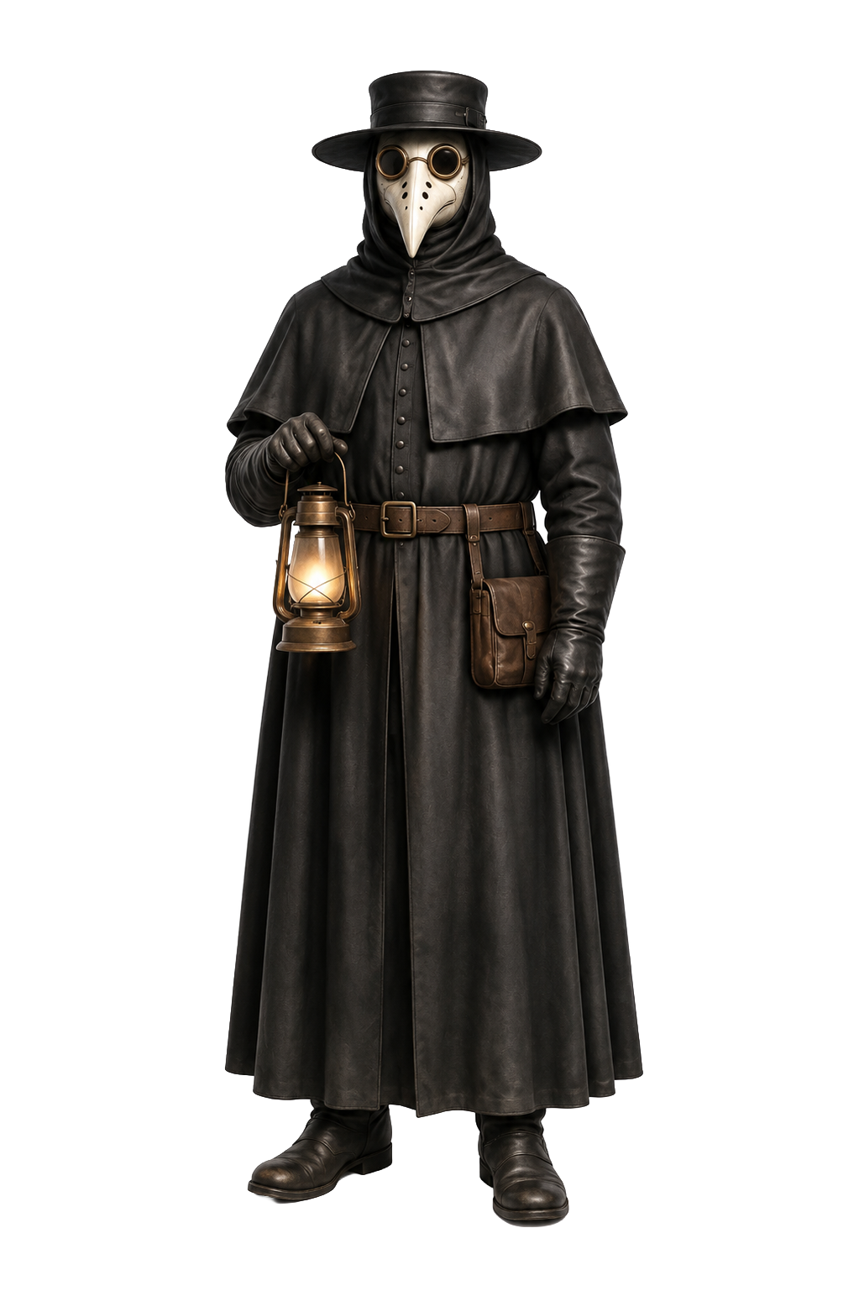

IIPW 2026
PAST.
PRESENT.
PROTECTED.
APIC thanks you for protecting patients, colleagues,
and communities.

