Slide 1

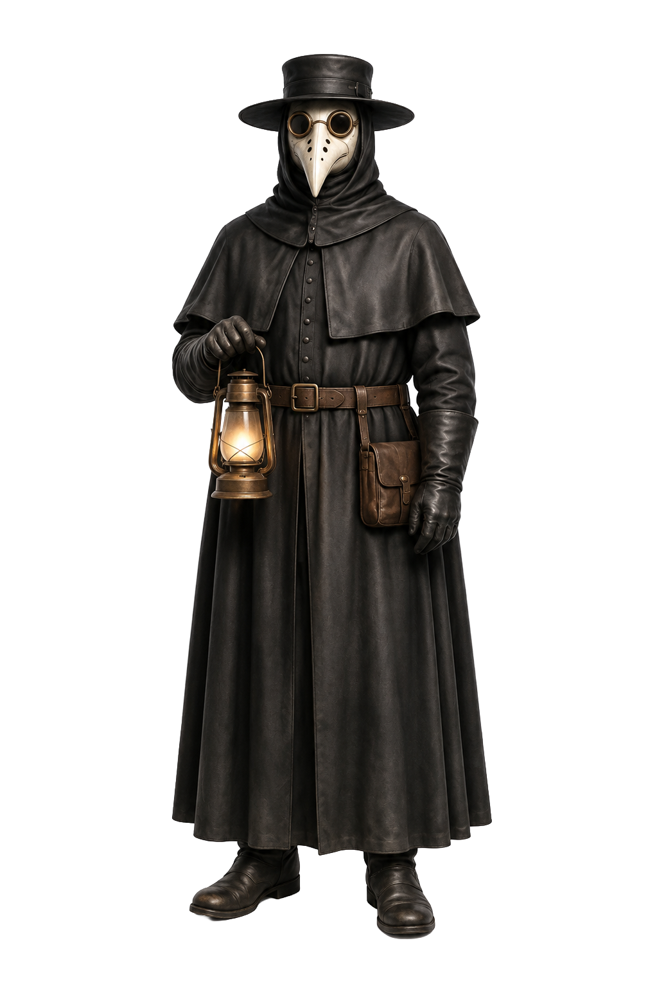
OUTBREAK DETECTIVE
Plague
Cholera
Five outbreaks. Five mysteries.
Can your team solve them all?
BEGIN INVESTIGATION

Slide 2
HOW TO PLAY
Become an Outbreak Detective
Work together. Read the evidence, discuss the four questions, then reveal the case.
1
Identify
2
Trace
3
Interrupt
4
Connect
What disease or outbreak does the evidence describe?
What was the important transmission route?
What IPC/public-health measure helped interrupt transmission?
What lesson still applies to infection prevention today?
SCORING
Award your team 1 point for each case correctly identified. Maximum score: 5.
OPEN CASE 1

Slide 3
CASE FILE 1
EVIDENCE
CLUE 1
CLUE 2
CLUE 3
Physicians are depicted wearing long, beaked masks.
Communities use isolation and quarantine during outbreaks.
The disease is historically associated with rodents and fleas.
TEAM QUESTIONS
1. What disease was it? 2. What was the transmission route?
3. What measure helped? 4. What lesson still applies today?
Discuss before revealing the case.
REVEAL CASE

Slide 4
CASE 1 SOLVED
Plague, including the Black Death pandemic
TRANSMISSION
WHAT HELPED
THEN → NOW
Primarily flea-borne transmission involving infected rodents; pneumonic plague can also spread person-to-person through respiratory droplets.
Isolation/quarantine and reducing exposure to infected fleas/rodents. Historical beaked masks were not equivalent to modern respirators.
Match precautions to the mode of transmission. Update practice as scientific understanding improves.
✓ If your team identified the disease correctly, add 1 point.
NEXT CASE 2
Notes:
Content sources: CDC plague case definition and transmission overview, https://ndc.services.cdc.gov/case-definitions/plague-2020/ . APIC subject-matter review recommended before publication.

Slide 5
CASE FILE 02
EVIDENCE
CLUE 1
CLUE 2
CLUE 3
Cases cluster around one neighborhood.
A physician maps deaths geographically.
A public water pump becomes the focus of the investigation.
TEAM QUESTIONS
1. What disease was it? 2. What was the transmission route?
3. What measure helped? 4. What lesson still applies today?
Discuss before revealing the case.
REVEAL CASE

Slide 6
CASE 2 SOLVED
Cholera
TRANSMISSION
WHAT HELPED
THEN → NOW
Fecal–oral transmission through contaminated water or food.
Stopping exposure to the contaminated water source, paired with sanitation and safe-water measures.
Epidemiologic patterns and environmental sources can reveal how transmission is occurring.
✓ If your team identified the disease correctly, add 1 point.
NEXT CASE 3
Notes:
Content source: CDC Emerging Infectious Diseases, Persistence of Memory and the Comma Bacillus, https://wwwnc.cdc.gov/eid/article/17/11/ac-1711_article . APIC subject-matter review recommended before publication.

Slide 7
CASE FILE 3
EVIDENCE
CLUE 1
CLUE 2
CLUE 3
Maternal deaths are unusually high in one maternity clinic.
Clinicians move between autopsies and patient care.
Hand cleansing dramatically reduces mortality.
TEAM QUESTIONS
1. What disease was it? 2. What was the transmission route?
3. What measure helped? 4. What lesson still applies today?
Discuss before revealing the case.
REVEAL CASE

Slide 8
CASE 3 SOLVED
Puerperal (Childbed) Fever
TRANSMISSION
WHAT HELPED
THEN → NOW
Contact transmission via contaminated hands of healthcare personnel.
Hand hygiene before patient contact.
Hand hygiene remains one of the most fundamental measures for preventing healthcare-associated infection.
✓ If your team identified the disease correctly, add 1 point.
NEXT CASE 4
Notes:
Historical teaching case: Ignaz Semmelweis and puerperal fever. APIC subject-matter review recommended before publication.

Slide 9
CASE FILE 4
EVIDENCE
CLUE 1
CLUE 2
CLUE 3
Communities limit large gatherings.
Masks are used in some cities and settings.
Crowding and close contact contribute to spread.
TEAM QUESTIONS
1. What disease was it? 2. What was the transmission route?
3. What measure helped? 4. What lesson still applies today?
Discuss before revealing the case.
REVEAL CASE

Slide 10
CASE 4 SOLVED
1918 Influenza Pandemic
TRANSMISSION
WHAT HELPED
THEN → NOW
Primarily respiratory transmission, especially during close contact.
Layered community measures included isolation of ill people, distancing/crowd reduction, ventilation, and mask use in some settings.
During respiratory epidemics, layered controls can reduce opportunities for transmission.
✓ If your team identified the disease correctly, add 1 point.
NEXT CASE 5
Notes:
Historical teaching case: 1918 influenza pandemic and layered community mitigation. APIC subject-matter review recommended before publication.

Slide 11
CASE FILE 5
EVIDENCE
CLUE 1
CLUE 2
CLUE 3
Healthcare workers use respirators such as N95s for higher-risk exposures.
Isolation precautions become a daily part of care.
mRNA vaccines become a major prevention tool.
TEAM QUESTIONS
1 What disease was it? 2 What was the transmission route?
3 What measure helped? 4 What lesson still applies today?
Discuss before revealing the case.
REVEAL CASE

Slide 12
CASE 05 SOLVED
COVID-19 (SARS-CoV-2 infection)
TRANSMISSION
WHAT HELPED
THEN → NOW
Respiratory transmission through infectious particles, with risk influenced by proximity, duration, ventilation, and other factors.
Layered measures include vaccination, appropriate respiratory protection/PPE, isolation when indicated, ventilation, and other source-control strategies.
Modern IPC combines longstanding principles with evolving evidence, technology, vaccination, and risk-based respiratory protection.
✓ If your team identified the disease correctly, add 1 point.
SEE WHERE YOU STAND
Notes:
Content sources: CDC Infection Control Guidance: SARS-CoV-2, https://www.cdc.gov/covid/hcp/infection-control/index.html and CDC Yellow Book COVID-19, https://www.cdc.gov/yellow-book/hcp/travel-associated-infections-diseases/covid-19.html . APIC subject-matter review recommended before publication.

Slide 13
CASE CLOSED
How did your team do?
0–1
NOVICE IP
Learning the foundations.
2
ADVANCED IP
Developing IPC knowledge.
3–4
SEASONED IP
Applying established IPC principles.
5
EXPERT IP
Demonstrating strong outbreak-investigation knowledge.
PLAY AGAIN
Use the discussion, not just the score, to connect historic outbreaks with today’s IPC practice.
For team learning and discussion. Review local policies and current guidance when applying these lessons.

